Slide 1

School of Computer Science and Engineering
Intelligent Learning Platform Development
External
Project Guide:
Prof. Durgarao Guttula
Assistant Professor
External Guide:
Anush G R
School of Computer Science and Engineering
RV University, Bangalore
Team members:
1RVU23CSE125 - C J Sakshi
1RVU23CSE162 - Gagana K
1RVU23CSE280 - Mohammed Ismail
1RVU23CSE369 - Rakshitha K

Slide 2
Contents
Title and Problem definition
Introduction & Scope
Objectives
Literature Survey
Methodology
Requirement Specification
Design approach
Architecture diagram
Innovation
Implementation
Testing
Hardware & Software Requirements
References

Slide 3
Problem Definition
Necessity and Benefits:
Traditional interviews require significant human effort and time.
Resume screening is often manual, subjective, and inconsistent.
Recruiters struggle to assess technical depth early in the hiring process.
Benefits:
Automates early-stage candidate screening
Ensures consistent and unbiased questioning
Saves recruiter time and cost
Provides structured feedback and scoring
This can be adopted for practicing the interviews beforehand for freshers and those who wants the experience of interviews.

Slide 4
Problem Definition
Relevance:
AI-based recruitment is widely adopted in industry HR systems
Relevant to AI, NLP, Software Engineering, and Data Science
Addresses real-world hiring challenges
Expected Outcomes:
Resume-based skill extraction
Adaptive interview question generation
Candidate capability scoring
Personalized dashboard for candidates

Slide 5
Introduction - Background
Background:
Growth in job applications makes manual screening infeasible
Existing systems rely heavily on keyword filtering
Lack of deep skill evaluation before interviews
Technology Context:
Advances in NLP and Large Language Models
Availability of cloud platforms and AI APIs

Slide 6
Problem Statement and Scope
To design and develop an AI system that:
Parses resumes
Extracts relevant skills
Conducts adaptive interviews
Evaluates candidate responses objectively
Scope of the Project
Included:
Resume upload and parsing
Skill extraction
Question generation
Answer evaluation
Excluded (current phase):
Live video interviews
Full enterprise ATS integration

Slide 7
Objectives
Primary Objectives:
Adaptive Assessment: Real-time difficulty scaling based on candidate mastery.
Multimodal Evaluation: Combined technical and behavioral (Vision AI) analysis.
Intelligent Tracking: Persistent "Growth Ledgers" to track technical gaps over time.
Specific Objectives:
Adaptive Logic: Implement 4-level questioning (Level 1 to Level 4).
Behavioral Vision: Analyze eye contact and confidence using Llama-3.2-Vision.
Active Memory: Use past technical weaknesses to personalize re-testing.
AWS Scalability: Build a stateless, serverless backend for massive user handling.
Automated Insights: Generate instant reports on accuracy, keywords, and soft skills.

Slide 8
Literature Survey
1. Resume Parser Using AI [1]
Problem Addressed
Manual resume screening is time-consuming and inefficient, especially when dealing with large numbers of applicants.
Methodology
The system uses Natural Language Processing (NLP) techniques to extract structured information from unstructured resume documents.
Key steps include:
Resume text extraction
Text preprocessing
Named Entity Recognition (NER)
Skill and experience extraction
Key Findings
AI-based resume parsing significantly improves recruitment efficiency by automatically extracting candidate information such as skills, education, and work experience.
Advantages
Reduces manual recruiter workload
Improves speed of candidate screening
Handles large numbers of resumes
Limitations
Works only at the resume screening stage
Does not evaluate candidate responses in interviews
Research Gap
Integration of resume parsing with interview automation systems is not explored.

Slide 9
Literature Survey
2. AI Bot for Interview Preparation [2]
Problem Addressed
Candidates often lack realistic environments for interview practice.
Methodology
The system uses:
React for frontend
FastAPI for backend
OpenAI API for question generation
Azure Speech Services for voice interaction
Key Findings
AI chatbots can simulate interview conversations and provide feedback to help candidates improve.
Advantages
Interactive interview simulation
Voice-based conversation
Immediate feedback
Limitations
Questions are mostly predefined
Limited personalization
Research Gap
Interview questions are not generated from candidate resumes.

Slide 10
Literature Survey
3. AI-Based Interview System with Machine Learning [3]
Problem Addressed
Traditional interviews cannot objectively evaluate candidate behavior and communication.
Methodology
The system uses multimodal AI analysis, including:
Speech recognition
Sentiment analysis
Facial expression recognition using computer vision
Machine learning classifiers
Key Findings
Analyzing both speech and facial expressions provides better candidate evaluation compared to text-only analysis.
Advantages
Captures behavioral indicators
More holistic candidate evaluation
Limitations
Requires cameras and audio processing
High computational cost
Research Gap
Lightweight web-based AI interview systems are not addressed.

Slide 11
Literature Survey
4. AI-Powered Interview Assistant Chatbot [4]
Problem Addressed
Recruitment processes require scalable interview solutions.
Methodology
The system uses conversational AI techniques:
NLP for conversation understanding
Voice-to-text conversion
Text-to-speech synthesis
Sentiment analysis
Key Findings
AI chatbots can simulate real interview conversations and assist candidates in preparing for job interviews.
Advantages
Realistic conversation simulation
Scalable interview platform
Limitations
Limited contextual reasoning
Static conversation flow
Research Gap
Dynamic follow-up question generation is missing.

Slide 12
Literature Survey
5. AI-Powered Mock Interview System for Automated Skill Assessment [5]
Problem Addressed
Candidates often lack tools to objectively assess interview performance.
Methodology
The system uses:
MERN stack architecture
NLP-based semantic similarity algorithms
Speech recognition
Candidate answers are compared with expected answers.
Key Findings
Semantic similarity scoring can evaluate candidate responses automatically.
Advantages
Automated answer evaluation
Helps candidates identify weaknesses
Limitations
Evaluation limited to text similarity
Does not analyze reasoning depth
Research Gap
Advanced reasoning models such as LLMs are not used.

Slide 13
Literature Survey
6. Automated Interview Bot for Hiring Process Optimization [6]
Advantages
Reduces recruiter workload
Handles large candidate pools
Limitations
Limited capability for complex discussions
Research Gap
Dynamic conversation and adaptive questioning are not implemented.
Problem Addressed
Recruitment processes involve repetitive manual interview stages.
Methodology
The system uses:
NLP-based question generation
Machine learning algorithms
Sentiment analysis
Key Findings
AI bots can conduct preliminary interviews and filter candidates efficiently.

Slide 14
Literature Survey
7. Automated Interview Assessment System [7]
Advantages
Real-time interview evaluation
Automated communication analysis
Limitations
Requires webcam and microphone
Privacy concerns
Research Gap
Lightweight text-based evaluation approaches are not explored.
Problem Addressed
Manual evaluation of communication skills in interviews is subjective.
Methodology
The system analyzes candidate performance using:
Speech-to-text conversion
Facial expression recognition
Grammar analysis
Key Findings
Voice fluency and facial expressions can provide indicators of candidate confidence and communication ability

Slide 15
Literature Survey
8. Interview Bot: Automating Recruitment Process Using NLP and ML [8]
Advantages
Consistent evaluation criteria
Scalable recruitment system
Limitations
Difficulty understanding complex responses
Research Gap
Advanced language models capable of deeper reasoning are not used.
Problem Addressed
Recruiters struggle to evaluate many candidates efficiently.
Methodology
The system uses:
NLP-based question generation
Speech recognition
Sentiment analysis
Machine learning evaluation models
Key Findings
Automated interview bots can standardize interviews and reduce bias.

Slide 16
Literature Survey
9. Best Practices in REST API Design for Scalability and Security [9]
Advantages
Improved backend reliability
Easier integration between systems
Limitations
Focuses on backend architecture only
Research Gap
Application of REST architecture in AI interview systems is not explored.
Problem Addressed
Web applications require scalable and secure API architecture.
Methodology
The paper analyzes REST architecture principles including:
Stateless communication
Resource-based API design
Versioning strategies
Security practices
Key Findings
Proper REST API design improves scalability and maintainability of distributed systems.

Slide 17
Literature Survey
10. Evaluating the Efficacy of Next.js [10]
Advantages
Faster page rendering
Improved user experience
Limitations
Focuses on frontend performance only
Research Gap
Application of Next.js in AI-driven interview platforms is not analyzed.
Problem Addressed
Traditional React applications suffer from performance and SEO limitations.
Methodology
The study compares Next.js and React applications using performance metrics such as:
First Contentful Paint
Time to Interactive
Key Findings
Next.js improves loading speed and SEO performance through server-side rendering.

Slide 18
Literature Survey
11. Groq LPU AI Inference Architecture [11]
Advantages
High-speed AI inference
Energy efficiency
Limitations
Focuses on hardware architecture
Research Gap
Application of LPU-based AI inference in recruitment systems is not explored.
Problem Addressed
Traditional GPU-based AI inference can be slow and energy-intensive.
Methodology
Groq introduces LPU (Language Processing Unit) architecture for efficient AI inference.
Key Findings
LPU architecture processes AI tokens in pipeline stages, enabling faster inference.

Slide 19
Proposed Methodology
Resume Ingestion: CV upload and automated skill extraction.
Active Memory: Identification of past performance gaps via DynamoDB.
Dynamic Generation: 4-level adaptive technical Q&A generation.
Multimodal Capture: Real-time Voice, Video, and Text input processing.
Evaluation Hub: Hybrid technical and Vision AI (Llama 3.2) analysis.
Adaptive Cycle: Logic-driven Hints, Retries, or Difficulty Progression.
Persistence: Final report generation and session history sync.

Slide 20
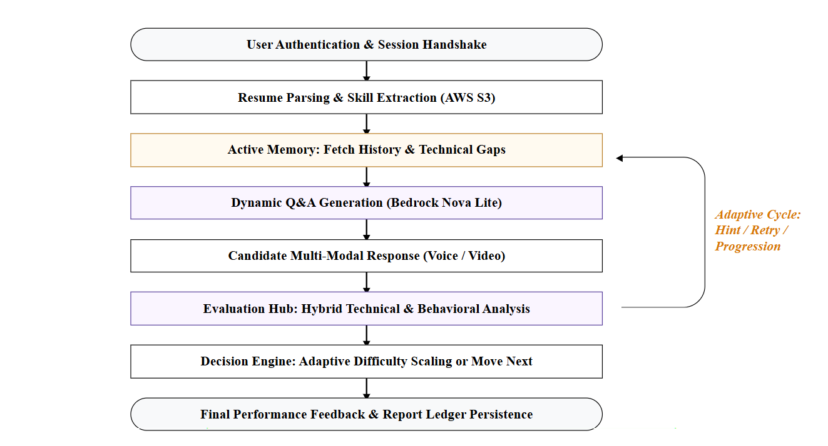
Proposed Methodology

Slide 21
Methodology - Data Collection & Analysis
Frameworks and Models:
Vision-Language Models: Llama 3.2 Vision for behavioral/confidence analysis.
Reasoning Engine: Bedrock Nova Lite for adaptive technical Q&A.
Backend Stack: High-performance FastAPI with AWS Lambda integration.
Data Collection Techniques:
Multimodal Input: Base64 video frames and real-time voice-to-text streams.
Document Tier: Resume PDFs stored in AWS S3 with automated parsing triggers.
Stateful Metadata: Performance "History Ledgers" from DynamoDB for RAG context.
Data Analysis Procedures:
Vision-Behavioral Hub: Synchronous frame analysis to detect eye contact, visibility, and presence.
Semantic Weakness Extraction: Identifying technical "Gaps" from user answers compared to industry-standard project requirements.
Adaptive Evaluation: Calculating "Difficulty Scores" to determine if the candidate moves to a higher-tier conceptual level.

Slide 22
Methodology - Data Collection & Analysis
Project Execution Steps:
Identity Handshake: Secure authentication and personalized dashboard initialization.
Context Loading: Resume skill extraction and historical performance rehydration.
The Adaptive Loop: Continuous cycle of Q&A, Multimodal evaluation, and Difficulty scaling.
Behavioral Sync: Real-time camera confidence scoring layered over technical accuracy.
Result Persistence: Final report generation and DynamoDB "Growth Ledger" update.
Quality Assurance Measures:
State Recovery Testing: Ensuring stateless Lambda functions can rehydrate interview context without data loss.
Vision LLM Guardrails: Preventing AI hallucinations by cross-referencing behavioral cues with technical performance.
Performance Latency Checks: Optimizing sub-second response times for Voice/Video stream processing

Slide 23
Design approach
Presentation Layer
Next.js 15 Frontend: Dynamic dashboard with Web Speech & MediaRecorder APIs for multimodal input.
Application Layer
FastAPI Brain: Handles consolidated prompting, adaptive logic scaling, and evaluation engine tasks.
Infrastructure Layer
AWS Cloud: Lambda (Compute), DynamoDB (State Ledger), S3 (Storage), API Gateway.
Groq/Bedrock API: High-speed inference for technical reasoning and Vision analysis.

Slide 24
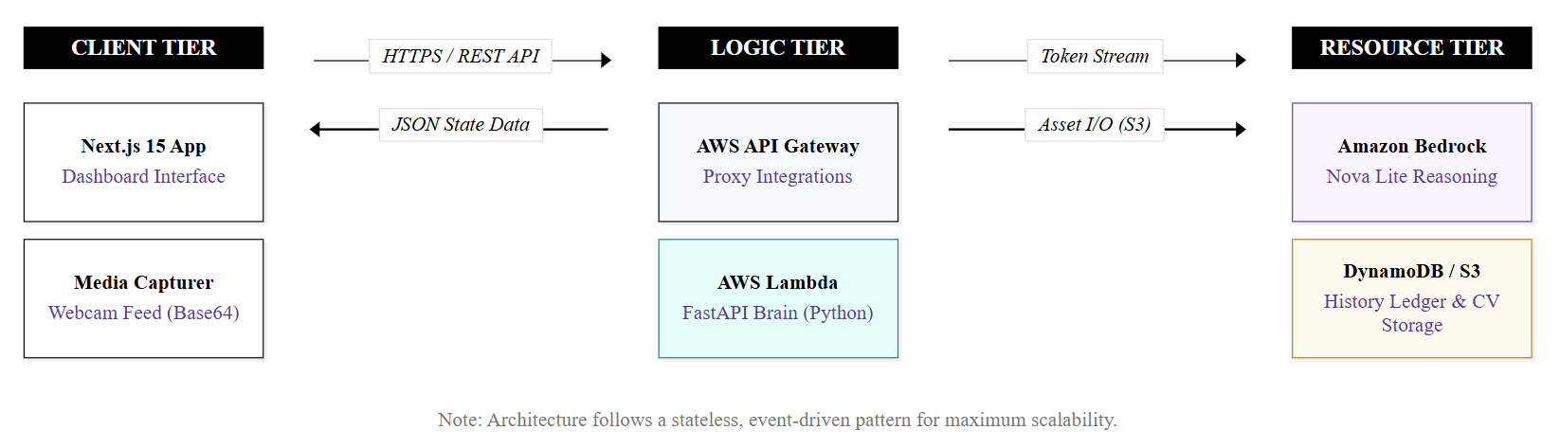
Architecture diagram

Slide 25
Requirement Specification
Project Objective and Functional scope
Adaptive Interview Engine: Implement 4-level difficulty scaling using Active Memory RAG.
Multimodal Input Processing: Capture and analyze Text, Voice, and Base64 Video frames.
Vision-Language Analysis: Integrate Llama 3.2 Vision for camera confidence and soft-skill scoring.
Skill-Gap Identification: Automated resume parsing to target specific candidate technical weaknesses.
Session Persistence: Generation of "Growth Ledgers" and historical report tracking via DynamoDB.
Data Requirements
The system processes the following data:
Candidate resumes (PDF/DOCX)
Extracted candidate skills
Candidate responses to interview questions
Interview evaluation metrics
All data is stored securely for interview history and analytics.
.
User Requirements
Secure authentication and personalized dashboard access.
Resume-based interview personalization and skill re-testing.
Multimodal response submission (Voice/Video/Text).

Slide 26
Requirement Specification
Functional Requirements (System Features)
Handshake Tier: CV parsing and automated skill extraction.
Logic Tier: Dynamic, context-aware question generation and difficulty scaling.
Evaluation Tier: Hybrid scoring using technical accuracy and behavioral analysis.
Persistence Tier: Secure storage of session history and PDF report generation.
Non-Functional Requirements (System Performance & Constraints)
Scalability: Event-driven architecture supports unlimited concurrent sessions.
Responsiveness: Sub-second latency for adaptive question generation and frame analysis.
Reliability: Stateless rehydration ensures zero data loss during session interrupts.
Integrity: Automated integrity checks for tab-switching and environment focus.
Operational Environment
Frontend Layer: Next.js 15 with integrated Web Speech & MediaRecorder APIs.
Logic Layer: FastAPI running on AWS Lambda (Stateless Architecture).
AI Inference: Groq (Llama 3.2) and Amazon Bedrock (Nova Lite).
Infrastructure: AWS DynamoDB (History Ledger) & AWS S3 (Asset Storage).

Slide 27
Innovations
Novelty in Concept:
Active Memory RAG: Unlike basic bots, our system uses a persistent DynamoDB Performance Ledger to track technical weaknesses over time and re-test them.
Multimodal Evaluation Hub: Synchronous analysis of Technical Alignment (NLP) and Behavioral Confidence (Vision AI) for a 360-degree candidate score.
Pedagogical Scaffolding: Implementation of "Hint/Retry" logic that calculates candidate Potential rather than just binary accuracy.
Technological Innovation:
Vision-Language Integration: Deployment of Llama 3.2 Vision for real-time camera eye-contact and presence detection.
Consolidated Reasoning Pipeline: A single-turn LLM architecture that performs Evaluation, Decisioning, and Next-Level Question Generation simultaneously.
Stateless Serverless Deployment: An event-driven AWS Lambda architecture ensuring infinite scalability with zero fixed costs.

Slide 28
Sustainability, Impact and Future Application
Social / Industry Impact:
Hiring Equity: Eliminating subconscious human bias through standardized, evidence-based AI evaluation.
Hyper-Scalability: Enabling organizations to perform 10,000+ concurrent screenings without increasing HR headcount.
Predictive Growth: Moving from "Pass/Fail" results to a "Growth Ledger" that maps a candidate’s learning trajectory.
Future Applications:
Enterprise Recruitment SaaS: A B2B platform for specialized high-volume tech hiring.
Institutional Mock Suites: Integration into University placement cells (like RVU) for large-scale student training.
Real-time Skill Certification: Continuous assessment tools for internal corporate upskilling.

Slide 29
Implementation
Consolidated Thinking Architecture: Developed a centralized "Evolve-Think-Ask" prompting engine that evaluates, decides difficulty, and generates questions in a single sub-second turn.
Stateless State Rehydration: Implemented a secure state-syncing pipeline between the Next.js 15 frontend and the AWS Lambda backend using a persistent DynamoDB ledger.
Multimodal Capture Pipeline: Engineered a real-time system to process high-frequency Base64 video frames and Voice-to-Text streams using Web Speech & MediaRecorder APIs.
Serverless Event-Driven Migration: Transitioned the architecture to a fully stateless AWS serverless environment to enable 100% scalability and zero infrastructure maintenance.

Slide 30
Testing
Adaptive Logic Calibration: Performed controlled trials using "Mock CV Profiles" to verify that candidates are accurately promoted or demoted across the 4-level difficulty scale.
Vision AI Thresholding: Optimized Llama 3.2 Vision thresholds to ensure accurate detection of eye contact and professional presence across varied lighting and hardware setups.
Stateless Resilience Testing: Verified that the interview "heartbeat" can successfully recover from tab-switching, browser refreshes, or network blips without losing the candidate's progress.
Integrity Verification (QA): Implemented and tested automated focus-loss detection to penalize tab-switching and ensure behavioral integrity during the session.
Latency Benchmarking: Measured and optimized the "Input-to-Question" cycle time to ensure sub-three-second response times for a natural interview flow.

Slide 31
Hardware and/ or System Requirement
Hardware:
Standard personal computer with camera and microphone.
Stable internet connection for sub-second cloud inference.
Software:
Frontend Layer: Next.js 15, Web Speech API, MediaRecorder.
Logic Layer: FastAPI hosted on AWS Lambda (Stateless compute).
Infrastructure Layer: AWS DynamoDB (Performance state) and AWS S3 (Asset storage).
Core AI Layer: Groq (Vision LLMs) and Bedrock Nova Lite (Reasoning).

Slide 32
References
[1] M. Chiranjeevi, “A Review Paper on Resume Parser Using AI,” International Journal of Creative Research Thoughts (IJCRT), vol. 12, no. 2, pp. 1–5, 2024.
[2] K. Waghmare, G. Patil, P. Bhalerao, and S. Shelke, “AI Bot for Interview Preparation,” International Journal of Scientific Research in Engineering and Management, 2024.
[3] P. Pandeya, S. Sharma, and A. Singh, “AI-Based Interview System with Machine Learning,” International Journal of Research Publication and Reviews, vol. 6, no. 2, pp. 1–6, 2025.
[4] A. Singh, R. Kumar, and S. Gupta, “AI-Powered Interview Assistant Chatbot,” International Journal of Scientific Research in Engineering and Development, vol. 8, no. 1, pp. 1–7, 2025.
[5] V. Verma, R. Singh, and P. Sharma, “AI-Powered Mock Interview System for Automated Skill Assessment,” International Journal of Scientific Research and Engineering Trends, vol. 11, no. 2, pp. 1–6, 2025.
[6] S. S. Chavan, P. Patil, and A. Deshmukh, “Automated Interview Bot for Hiring Process Optimization,” International Journal of Engineering Research & Technology, vol. 13, no. 4, pp. 1–5, 2024.

Slide 33
References
[7] S. Vasekar, A. Patil, and P. Kulkarni, “Automated Interview Assessment System,” International Journal of Novel Research and Development, vol. 10, no. 3, pp. 1–5, 2025.
[8] A. Caldera, S. Perera, and K. Silva, “Interview Bot: Automating Recruitment Process Using Natural Language Processing and Machine Learning,” Proceedings of the International Conference on Artificial Intelligence and Applications, pp. 45–50, 2023.
[9] G. N. Ashwath and G. Priyanka, “Best Practices in REST API Design for Enhanced Scalability and Security,” Journal of Artificial Intelligence, Machine Learning and Data Science, vol. 4, no. 2, pp. 120–128, 2024.
[10] S. Pati and Y. Zaki, “Evaluating the Efficacy of Next.js for Modern Web Applications,” arXiv preprint arXiv:2501.12345, 2025.
[11] S. Raghavan, I. Arsovski, and D. Maheshwari, “Groq LPU: A New Architecture for AI Inference,” Groq Technical Whitepaper, 2024.

Slide 34
Thank You

